Slide 1

Ecommerce Data
Patrick Hearin Ph.D.

Slide 2
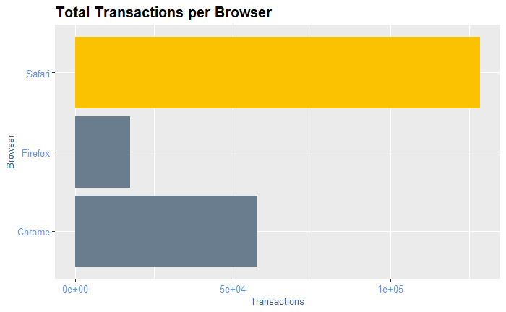
Safari Browswer
Safari browser had the most transactions.
Furthermore, Safari had the most sessions, quantity, and ECR.

Slide 3
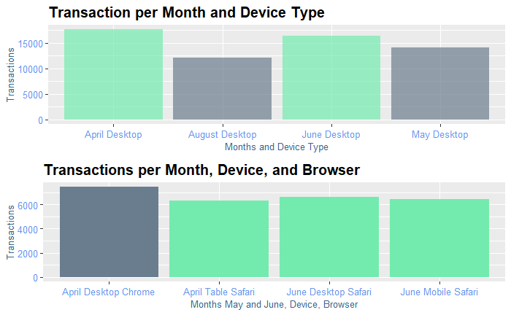
Comparison of totals
The most transactions were in April on a desktop.
The largest contributors to April were Chrome on a desktop and Safari on a Tablet.
Although Safari had the largest contributions to transactions from all three types of devices.

Slide 4
Transactions per Device
This animation shows how transactions are accumulated over the dates in the dataset.
Overall, desktops dominate transactions.
From the previous slides the largest contributors were Chrome and Safari.

Slide 5
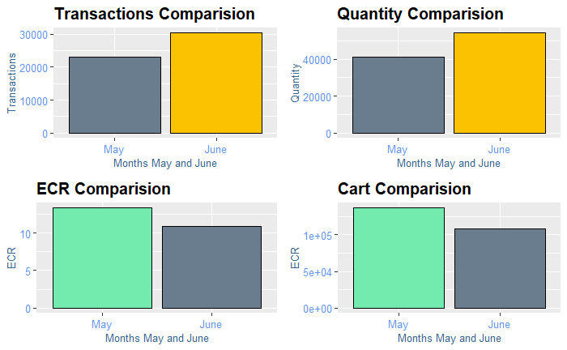
Consecutive Month Comparison
The graphs show the most recent months in the data set.
June had more transactions and quantity.
May had more ECR and adds to cart.

